Slide 1

  TECHNICAL PRESENTATION
  Microservices Architecture in Cloud Environments
  A . Tharun Kumar reddy(192572068)
  K . lohith kumar (192511155)
  CSA1520 – Cloud Computing and Big Data Analytics
  Guided By Students Name
  Dr.A.M.Arul Raj A. Tharun kumar reddy
  Professor (192572068)
  Institute lohith kumar 192511155)
  SIMATS Engineering SIMATS Engineering
Notes:
1
1

Slide 2
Abstract
Microservices is a modern software architecture.
It divides a large application into small, independent services.
Each service performs a specific function.
Services communicate through APIs.
Each service can be developed and deployed separately.

Slide 3
Aim and Objective
Aim
To understand Microservices Architecture in Cloud Environments.
To learn how large applications are divided into small services.
Objectives
Understand the basic concept of microservices.
Learn how microservices are designed and connected.
Compare microservices with monolithic architecture.

Slide 4
Introduction
Microservices is a modern software architecture.
It divides a large application into small and independent services.
Each service performs a specific task.
Services communicate with each other using APIs.

Slide 5
Core Technical Explanation
Microservices: Divides one large application into small independent services.
Independent Services: Each service handles one specific function.
API Gateway: Receives user requests and sends them to the correct service.
Service Communication: Services communicate using APIs such as REST o

Slide 6
Existing System
Traditional applications often use Monolithic Architecture.
The entire application is developed as one large system.
All functions are connected within a single application.
A small change may require updating the whole application.

Slide 7
Proposed System
The proposed system uses Microservices Architecture in a cloud environment.
The application is divided into small and independent services.
Each service performs a specific function.
An API Gateway manages requests from users.

Slide 8
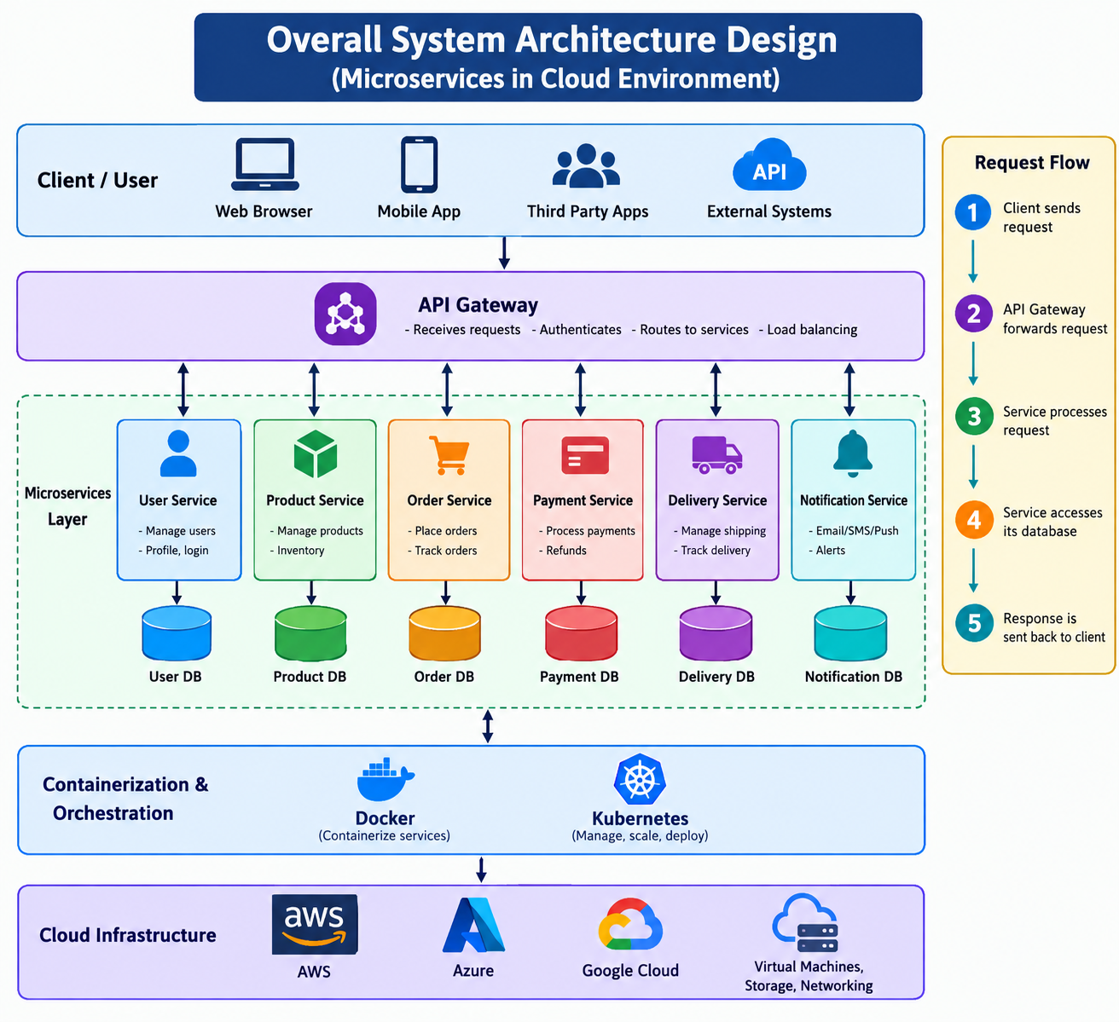
Overall System Architecturel Design

Slide 9
Proposed Methodology and Algorithm
Identify the main functions of the application.
Divide the application into small independent microservices.
Create APIs for communication between services.
Use separate databases for different services when required.

Slide 10
Conclusion
Microservices divide a large application into small independent services.
Each service performs a specific function.
It is more flexible than a monolithic system.
Services can be developed, deployed, and scaled independently.

Slide 11
References
Newman, S. (2021). Building Microservices: Designing Fine-Grained Systems. O’Reilly Media.
Richardson, C. (2018). Microservices Patterns. Manning Publications.
AWS (2025). Implementing Microservices on AWS.
Microsoft Azure (2025). Microservices Architecture Style.
Microsoft Azure (2025). Design a Microservices Architecture.
Google Cloud (2025). What is Microservices Architecture?

